Slide 1

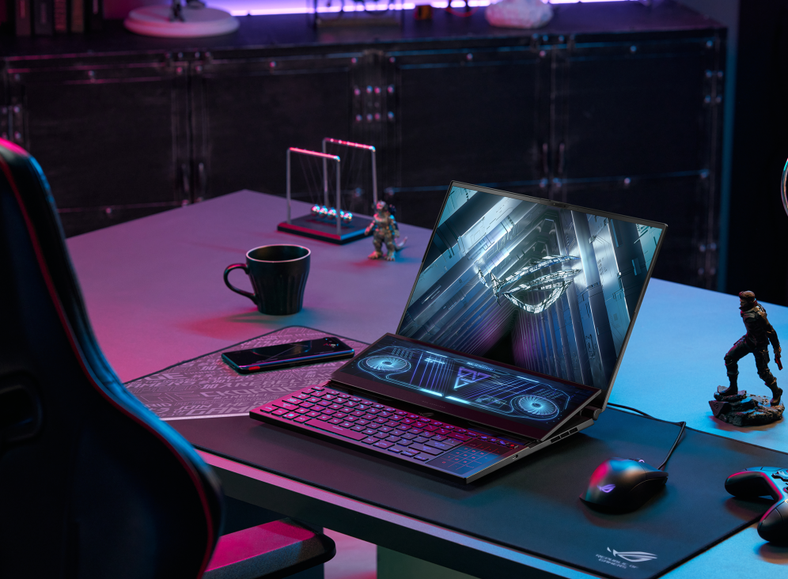


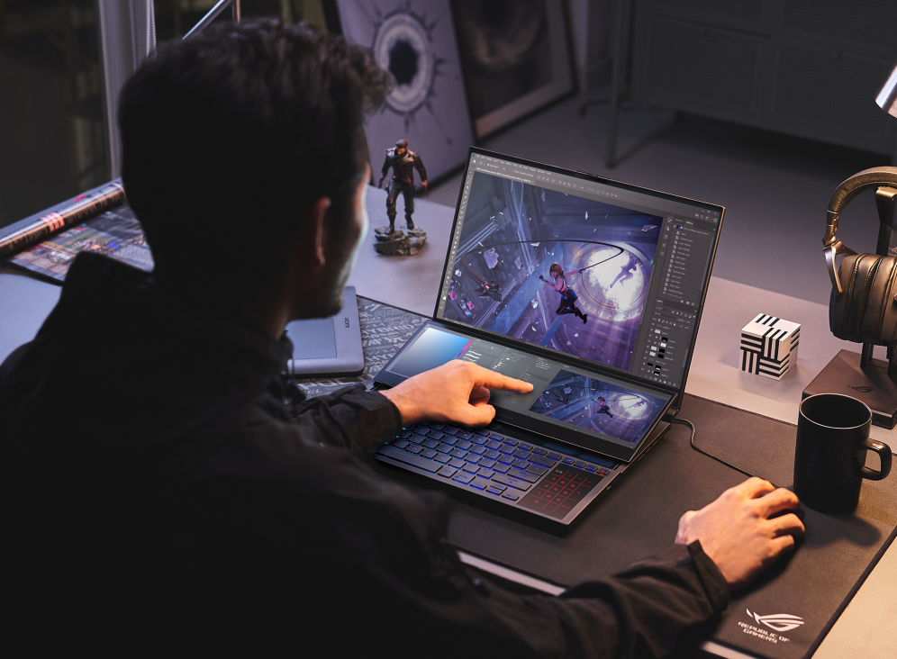
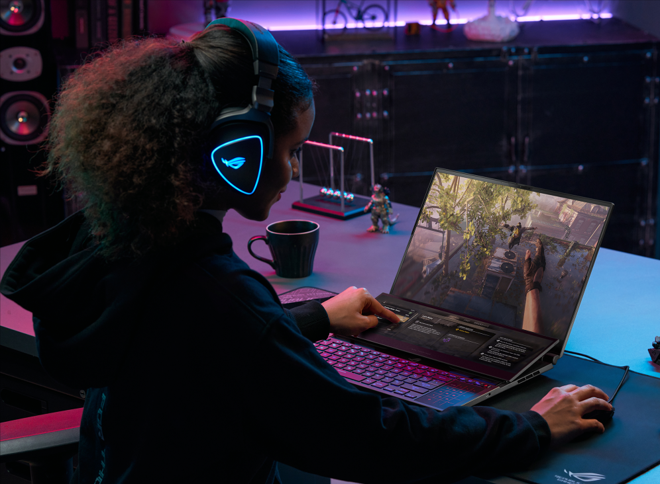
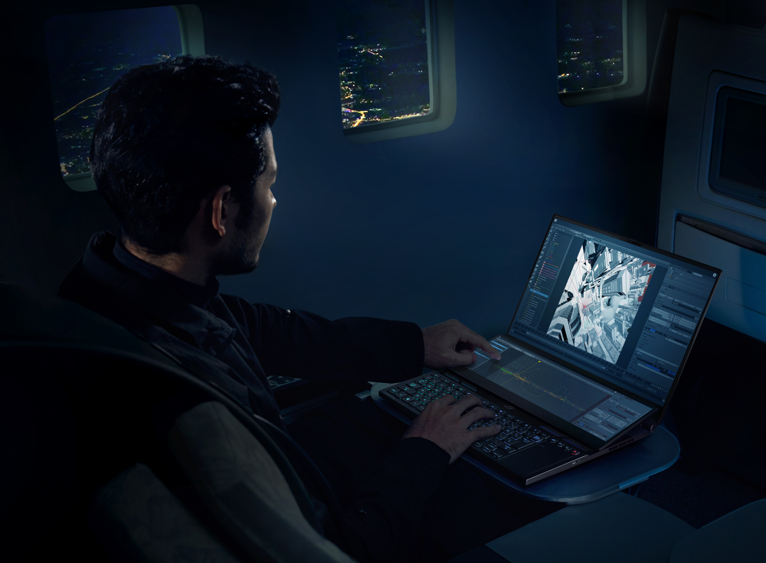
ACCORDION
NAVIGATION
ROG ZEPHYRUS DUO 16
TWO SCREENS
CPU& GPU
DISPLAY
COOLING
2023
Notes:
https://unsplash.com/photos/9XngoIpxcEo

Slide 2
ACCORDION
NAVIGATION
ROG ZEPHYRUS DUO 16
TWO SCREENS
True multitasking with a seamless 14.1” touchscreen secondary display
CPU& GPU
DISPLAY
COOLING
2023
Notes:
https://unsplash.com/photos/9XngoIpxcEo

Slide 3
ACCORDION
NAVIGATION
ROG ZEPHYRUS DUO 16
TWO SCREENS
CPU& GPU
Ryzen™ 9 6000 series​ CPU and GeForce RTX™ 3080 Ti Laptop GPU at 165W TGP and MUX Switch
DISPLAY
COOLING
2023
Notes:
https://unsplash.com/photos/9XngoIpxcEo

Slide 4
ACCORDION
NAVIGATION
ROG ZEPHYRUS DUO 16
TWO SCREENS
CPU& GPU
DISPLAY
Superior visuals for any occasion with a Nebula HDR Display™ with Mini LED or a Dual Spec Panel with 4K and 240Hz modes
COOLING
2023
Notes:
https://unsplash.com/photos/9XngoIpxcEo

Slide 5
ACCORDION
NAVIGATION
ROG ZEPHYRUS DUO 16
TWO SCREENS
CPU& GPU
DISPLAY
COOLING
Cooling you can feel, not hear, with 30% better airflow from AAS Plus 2.0
2023
Notes:
https://unsplash.com/photos/9XngoIpxcEo

